Slide 1









Idea submission

Slide 2


Team details
Team Lead: Name:vedant j
Contact: 9731708644
Email:jonnale.2004@gmail.com
Team Member 2: Name:shreya
Contact: 9945974106
Email: shreyajaganatha.ci23@bmsce.ac.in
Team Member 3: Name:Chetan m
Contact: 9148358140
Email:Chetan.mvk@gmail.com

Slide 3


Our solution
Decentralised AI based taxing system

Slide 4

TECHNICAL APPROACH
Js
Css
Html
.env
ChatGPT
Deepseek

Slide 5
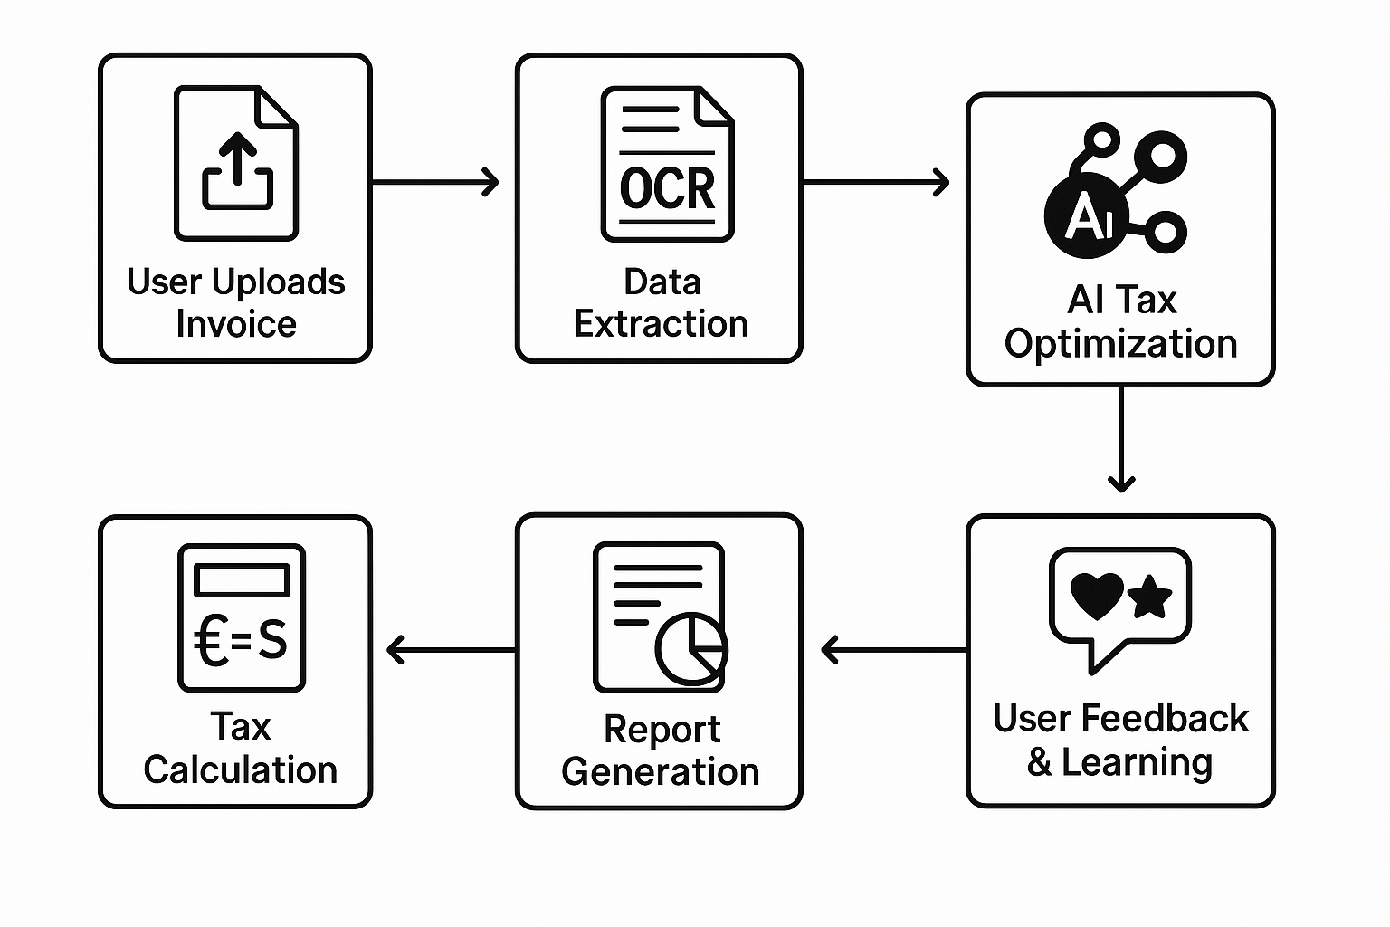
Workflow/pipeline

Slide 6
Feasibility & FUTURE SCOPE
Pros (Advantages):
Automation & Efficiency
Tax Optimization
Error Reduction.
Cost Savings
User-Friendly .
Scalability
Cons (Disadvantages):
Data Privacy Concerns Legal Compliance Risks
Dependence on Accurate Data –

